Slide 1
Original EMOSA specification
alternative EMOSA specification
Hybrid
Contagion
Diffusion

Slide 2
Original EMOSA specification
alternativePlus EMOSA specification
Hybrid
Contagion
Diffusion

Slide 3
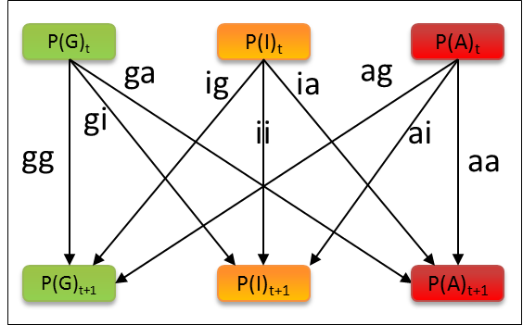
NewDiffusion
NewContagion
NewHybrid

Slide 4
P(G)_{t}
P(I)_{t}
P(A)_{t}
ii
gg
aa
ig
gi
ai
ia
ag
ga
P(G)_{t+1}
P(I)_{t+1}
P(A)_{t+1}

Slide 5
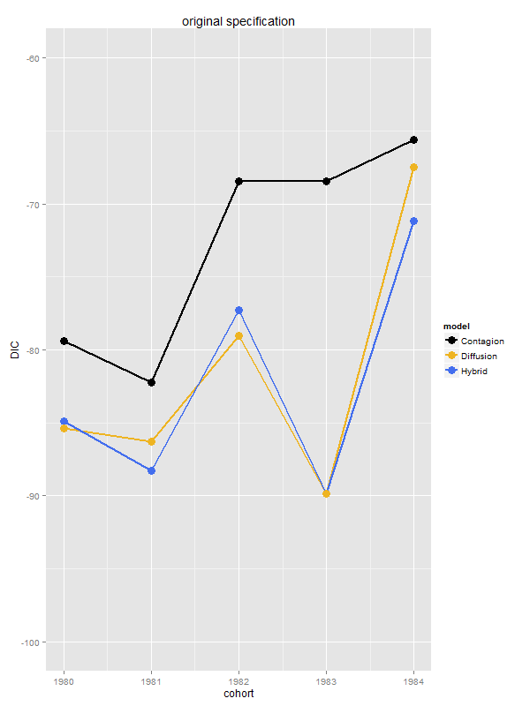
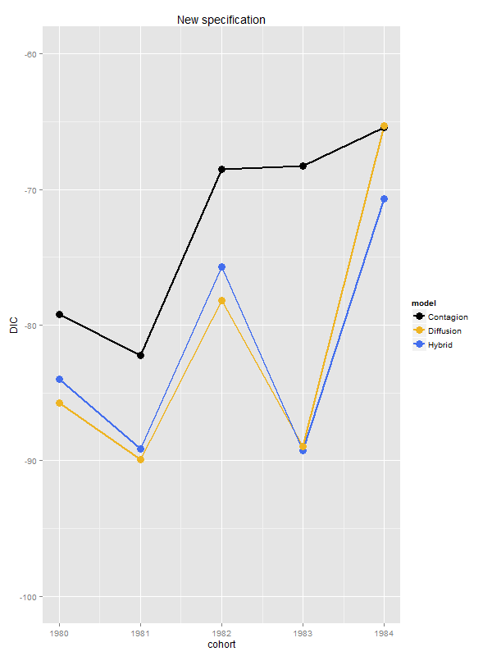

Slide 6
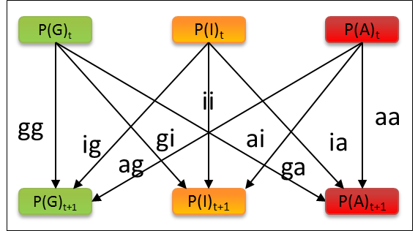
Diffusion
Contagion

Slide 7
Diffusion

Slide 8
Diffusion
Contagion

